Slide 1
Tittle
“ BPaaS ”

Slide 2
Intro
What is BPaaS ?

Slide 3
Stand for :
Business Process as a Service
Business process as a service (BPaaS) is a term for a specific kind of Web-delivered or cloud hosting service that benefits an enterprise by assisting with business objectives. In the general sense, a business process is simply a task that must be completed to benefit business operations. Using the term (BPaaS) implies that the business process is being automated through a remote delivery model.

Slide 4
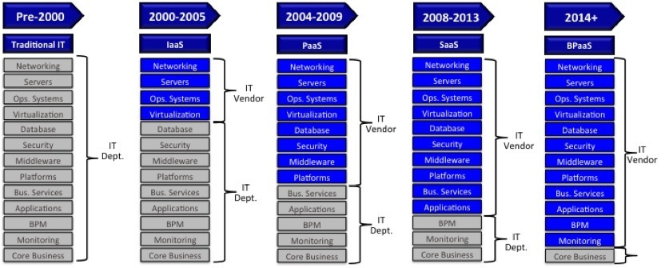
Transformation Technology

Slide 5
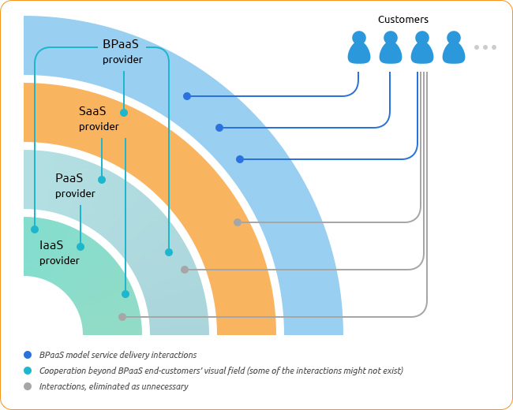
BpaaS Model

Slide 6
Characteristic
The following characteristics define BPaaS:
The BPaaS sits on top of the other three foundational cloud services: SaaS, PaaS, and IaaS.
A BPaaS service is configurable based on the process being designed.
A BPaaS must be able to support multiple languages and multiple deployment environments because a business cannot predict how a business process will be leveraged in the future.
A BPaaS environment must be able to handle massive scaling. The service must be able to go from managing a few processes for a couple of customers to being able to support hundreds if not thousands of customers and processes. The service accomplishes that objective by optimizing the underlying cloud services to support this type of elasticity and scaling.

Slide 7
Example of BPaaS
For a concrete example of BPaaS, think about certain kinds of tasks that businesses may need done on a regular basis. One example is transaction management. Credit card transactions may need to be recorded in a central database, or otherwise handled or evaluated. If a vendor can offer a company that same task performed and delivered through cloud hosted networks, that would be an example of BPaaS.
In delivering business automation remotely, vendors can help companies to plan even more efficiency into their operations. This is the kind of idea that BPaaS services address.

Slide 8
BPaaS software / provider
Adempiere
Dell Health Plan
One Source Virtual
HANA Cloud Platform (HCP)
Dll

Slide 9
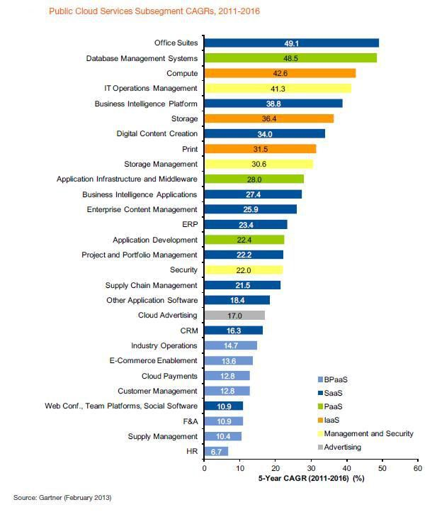
Public Cloud Service 2011 - 2016

Slide 10
BPaaS Economic Aspect
Customer’s Return on Investment
The invoice approval process handling takes from one to three employees. An AP specialist’s average annual salary in the US is $38,220, which means that the business task performance costs the company $38,200­­­–$114,660 per month. Therefore, if your BPaaS solution costs less than $75,000 per year, you benefit from AP specialists’ payroll costs reduction. Besides, the BPaaS option offers corporate system administration cost savings, considering that IT specialist’s average annual salary in the US is $77,330.

Slide 11
BPaaS Economic Aspect
BPaaS Provider’s Profit
The provider’s business profitability depends on the cloud system cost on the one hand, and on the price agreed by the end-customer on the other hand. Plus, both restrictions are external, and the provider cannot influence them.
As a result, the provider accepts some profitability of their business and can earn on volumes, purchasing more and more facilities to be able to handle more customers’ requests. The critical points for a BPaaS provider are software purchase licensing model as well as SaaS solution scalability and architecture that allows using one database for supporting a variety of customers. Under these conditions one can increase profit margin by gaining volumes.

Slide 12
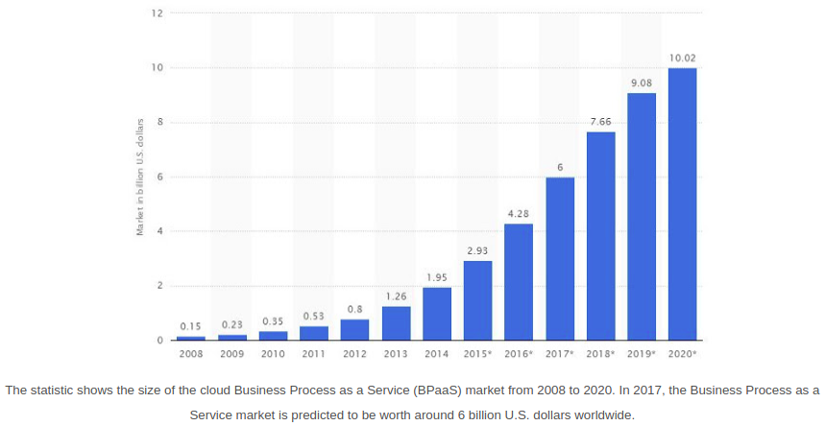
BPaaS in the Future

